Slide 1
NPTEL
Video Course on Machine Learning
Professor Carl Gustaf Jansson, KTH
Week 6 Machine learning based on
Artificial Neural Networks
Video 6.1 Fundamentals of Part 1
Artificial Neural Networks

Slide 2
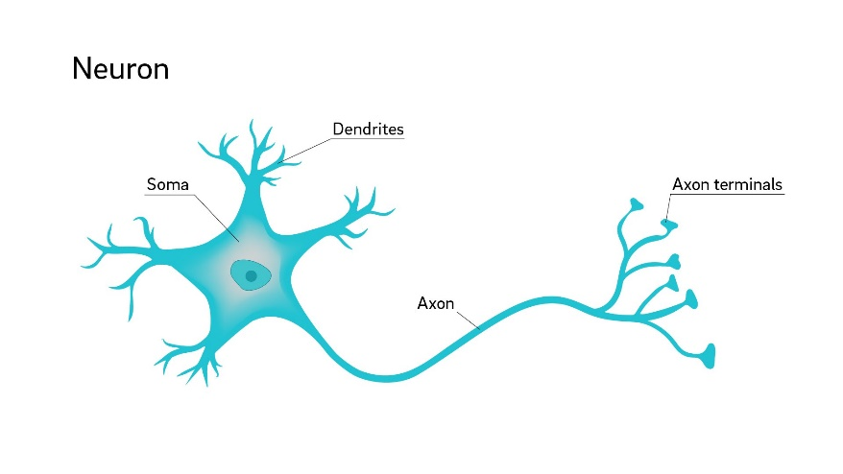
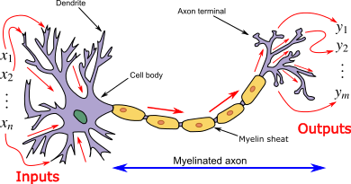
Interdisciplinary sources of inspiration for this representation
ANN are inspired by the way neuron systems work in the human (animal) nervous system as investigated
in Neuro Science.
A Neuron, is an electrically excitable cell that receives, processes, and transmits information
through electrical and chemical signals. A typical neuron consists of a cell body (soma), dendrites (input channels),
and an axon (output channel). The excitation of a signal is called ´firing´.
Dendrites are thin structures that arise from the cell body, often extending for hundreds of micrometers and branching
multiple times. An axon is a special cellular extension that arises from the cell body and travels for a distance,
as far as 1 meter in humans.
An axon from a presynaptic neuron meets the dendrites of a postsynaptic neuron at a synapse.

Slide 3
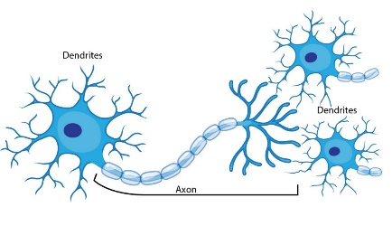
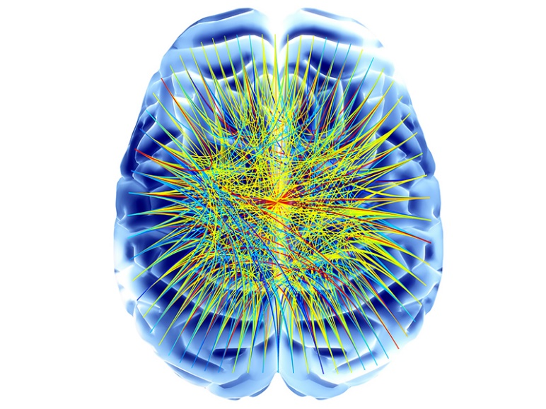
Neurons form huge structures and process in parallell
The human brain is assumed to have in the order of
100 Billion neurons and
10 000 times as many connections
with the potential of large scale parallell activity.

Slide 4
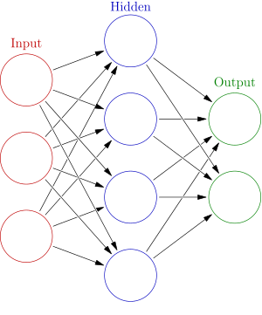
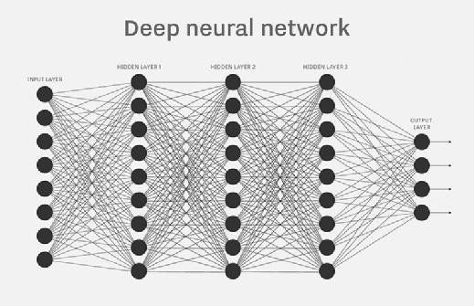
General characteristics of this Representation
Abbreviation: ANN (Artificial Neural Network)
An ANN is a network of nodes (units) called Artificial Neurons connected by 'edges'. The corresponding graph is directed. Typically there is one layer of input
nodes, one layer of output nodes and an arbitrary number of hidden layers.
Edges typically have a weight that can be adjusted. The weight increases or decreases the strength of the connection.
The output of each Artificial Neuron is typically computed by some non-linear function of the sum of its inputs if their sums exceeds some threshold.
Neurons can potentially fire in parallell but may also be temporally constrained.
Artificial Neurons are aggregated into layers. Different layers may perform different kinds of transformations on the inputs.
Signals typically travel from the input layer, to the output layer, possibly after traversing the layers multiple times. Hidden layers may have loops (e.g. Recurrent Neural Networks). The process of running an ANN for all data-items in a dataset is called an Epoque.

Slide 5
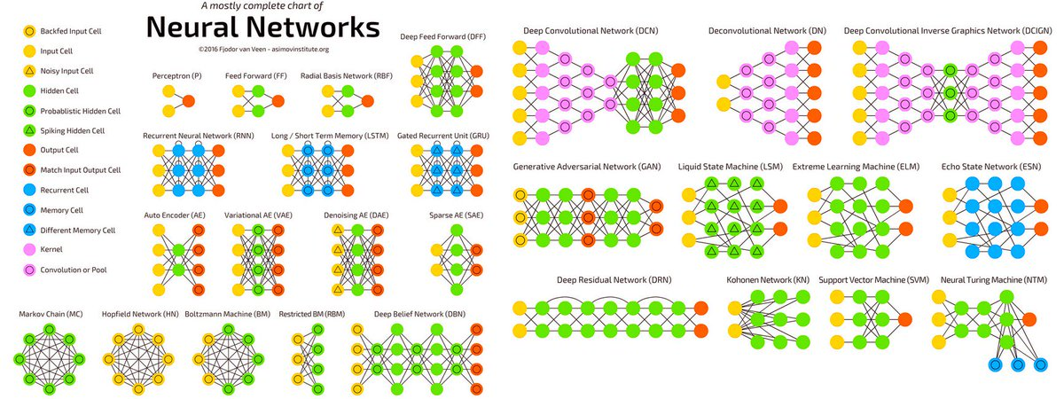
Chart illustrating the variations of network structures

Slide 6
Inputs Weights Transfer f. Output
Abstract model of a single neuron
Edges xi typically have a weight wi that can be adjusted. The weight increases or decreases the strength of the connection.
Artificial Neurons have a threshold T such that the signal is only sent if the aggregate signal from all input edges crosses that threshold. The negation of
the threshold we call the bias B of the neuron.
The output of each Artificial Neuron is typically computed by some non-linear function F of the sum of its inputs.
Y = if Σ ( wi xi ) >= T then F ( Σ ( wi xi ) - T )
i=1..n
To be able to handle the threshold parameter symmetrically with the weights we remodel it as an extra input as shown to the right where w0 =B = -T and x0=1.
Y = if Σ ( wi xi ) + wo*x0 >= 0 then F ( Σ ( wi xi ) + wo*x0 )
i=1..n
x1
F(Σ(wi xi)-T)
w1
x2
Y
w2
wn
xn
Threshold = T
Inputs Weights Transfer f. Output
x1
F(Σ(wi xi)-T)
w1
x2
Y
w2
Xn
wn
w0 = B=-T
X0=1

Slide 7
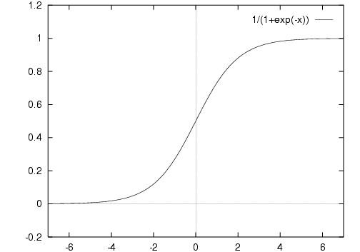
Example of a single episode of ´firing´ of a single neuron
X1=5
F(Σ(wi xi)-T)
W1=0.8
X2=5
Y=F(7-3)=1.0
(0.8*5+0.3*5+0.5*3)=7
W2=0.3
W3=0.5
X3=3
Threshold = 3
Y = if Σ ( wi xi ) >= T then F ( Σ ( wi xi ) - T )
i=1..n
F = Sigmoid function
X1=5
F(Σ(wi xi)-T)
W1=0.8
X2=5
Y=F(4)=1.0
(0.8*5+0.3*5+0.5*3 -3 *1)=4
W2=0.3
W3=0.5
X3=3
W0 =-3
Bias = - 3
Y = if Σ ( wi xi ) +w0x0 >= 0 then F ( Σ ( wi xi ) + w0 x0)
i=1..n
X0=1

Slide 8
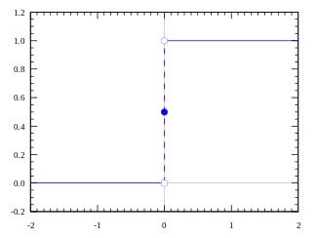
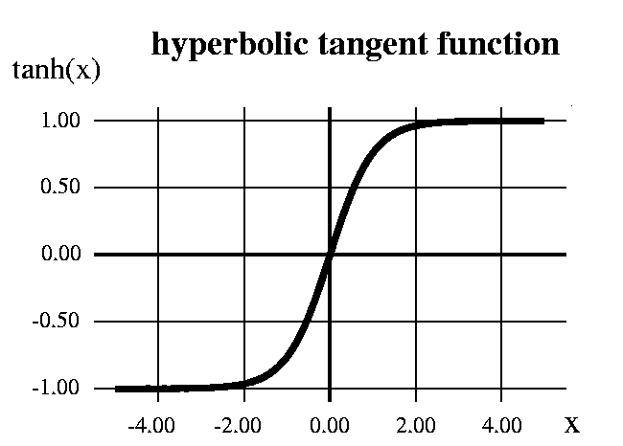
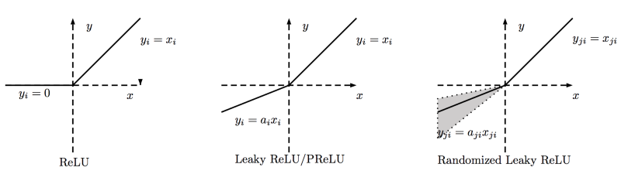
Selection of Activation Functions
Sigmoid
Step function
ReLU = Rectified Linear Unit

Slide 9
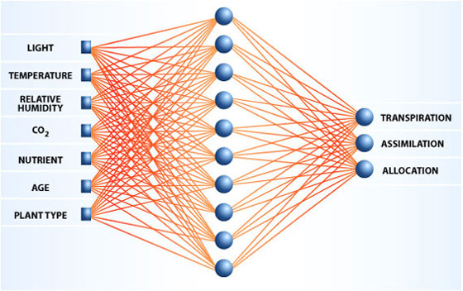
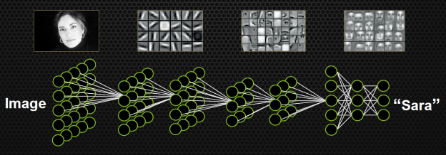
Problem solving for this Representation
Problem solving takes the following form:
Problem cases (in arbitrary alternative representation) has to
be mapped onto the neurons in the input layer.
The neural computation takes place.
Desired problem solutions (in arbitrary alternative representation)
have to be modelled in terms of the units of the output layer.
The mappings become more or less complex depending
on the character of the features. Sequences of input and
non-symbolic case representaions (e.g. Speech and images)
have to be given special consideration.

Slide 10
The Childhood of Artificial Neural Networks
1943 Warren McCulloch and Walter Pitt introduced Neural Networks as a model of computation.
"A Logical Calculus of the Ideas Immanent in Nervous Activity“.
1947 Donald Hebb presents a theory of synaptic learning that has strongly influenced the field of ANN.
“The Organization of Behavior”
1956 Marvin Minsky and Dean Edmonds designed and built SNARC, the first Neural Network machine able to learn.
“Theory of Neural-Analog Reinforcement System and its Applications to the Brain-Model Problem”
1957 Frank Rosenblatt invents the Perceptron in 1957, while working at the Cornell Aeronautical Laboratory.
´The perceptron, a perceiving and recognizing automaton”
D. H. Hubel and T. N. Wiesel published their Nobel Prize rewarded work on the visual system
´Receptive fields, binocular interaction and functional architecture in the cats´s visual cortex´,
1968 Alexey Ivakhnenko published work in USSR highly relevant for supervised, feedforward, multilayer perceptrons.
"The Group Method of Data Handling - a Rival of the Method of Stochastic Approximation".
Simon Papert and Marvin Minsky analyzes the strength and weaknesses of perceptrons.
“An Introduction to Computational Geometry”
1986 David Rumelhart, Geoffrey Hinton & Ronald Williams published the key article on learning in multilayer networks
“Learning representations by back-propagating errors”
Rina Dechter introduced the term Deep Learning, but not primarily in the context of ANNs.
“ Learning while searching in constraint satisfaction problems”

Slide 11

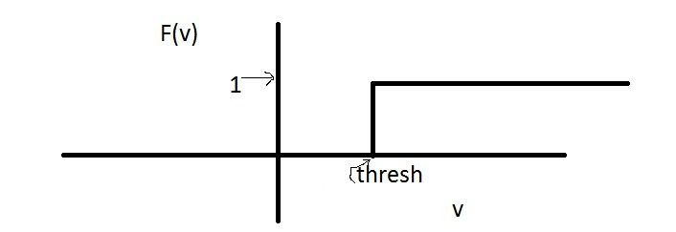

McCulloch and Pitts (1943)
The first artificial neuron model was first proposed by Warren McCulloch and Walter Pitts in 1943. The model was specifically targeted as a computational model of the "nerve net" in the brain.
The approach is also referred to as the Threshold Logic Unit, Linear Threshold Unit or Threshold Logic Gate model.
A neuron has a binary output (0,1)
It has excitatory as well as inhibitory inputs.
A neuron receives inputs from excitatory synapses, all having identical weights.
An Inhibitory input has an absolute veto power over any excitatory inputs
A neuron computes a weighted sum and has as a transfer function a fixed threshold
These networks displayed no learning. They were essentially "hard-wired" logic devices.
The purpose of the model was to show that logical operations like AND or OR could be modelled. It was observed from the beginning
that the implementation of the non-linear XOR needed several neurons.
AND if threshold=1
OR if threshold=2

Slide 12
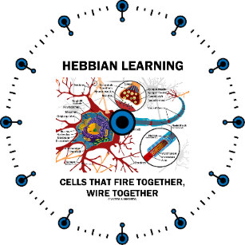
Hebbian Learning (1947)
Hebbian learning theory is a neuroscientific theory claiming that an increase in synaptic efficacy arises from a presynaptic cell's repeated and persistent stimulation of a postsynaptic cell. It is an attempt to explain synaptic plasticity, the adaptation of brain neurons during the learning process.
In an ANN setting the plasticity is implemented through adpation of weights.
The theory was introduced by Donald Hebb in his 1949 book The Organization of Behavior. The theory is also called Hebb's rule, Hebb's postulate or Cell Assembly theory. The theory is often summarized as "Cells that fire together wire together.
Hebb states it as follows: ´Let us assume that the persistence or repetition of a reverberatory activity (or "trace") tends to induce lasting cellular changes that add to its stability. ... When an axon of cell A is near enough to excite a cell B and repeatedly or persistently takes part in firing it, some growth process or metabolic change takes place in one or both cells such that A's efficiency, as one of the cells firing B, is increased´
As it turns out neuro A has to fire slightly before B (temporal precedence)and not fully in parallell to manifest the causality relation. This elaboration of Hebb´s work is called spike-timing-dependent plasticity (STDP).

Slide 13
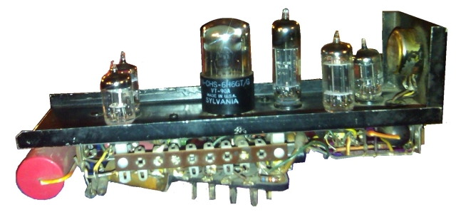
SNARC (1956)
SNARC (Stochastic Neural Analog Reinforcement Calculator) is a neural net machine designed by Marvin Minsky.
The machine is a randomly connected network of approximately 40 Hebb synapses. These synapses each have a memory that holds the probability that a signal comes in one input and another signal will come out of the output.
There is a probability knob that goes from 0 to 1 that shows this probability of the signals propagating. If the probability signal gets through, a capacitor remembers this function and engages a "clutch".
At this point, the operator will press a button to give reward to the machine. At this point, a large motor starts and there is a chain that goes to all 40 synapse machines, checking if the clutch is engaged or not.
This machine is considered one of the first pioneering attempts in the field of artificial intelligence.
One Synapse out of 40

Slide 14
To be continued in Part 2

